Slide 1
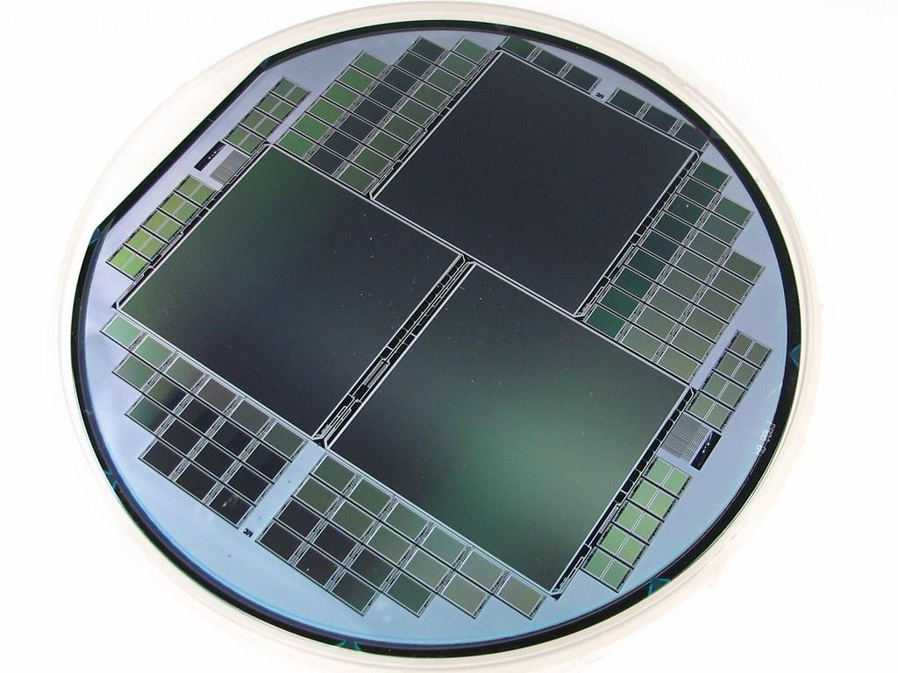
EAS 508 Statistical Learning and Data Mining – I
A data-driven quality analysis of Semiconductor Wafers

Slide 2


TEAM MEMBERS
Venkateswararao Para 50442199
Sanjana Chalavadi 50442673
Akhil Katha 50442207
Suriya Badrinath 50442121
Dongkyu Lee 50039553

Slide 3


DOMAIN KNOWLEDGE
WHAT IS A SEMICONDUCTOR WAFER ?
A thin slice of semiconductor substance, like crystalline silicon, used in electronics for the making of integrated circuits.
WHY DO WE NEED TO BUILD A MODEL?
Data mining and machine learning principles to build a model that predicts the product quality based upon the descriptors measurement values.
Hence, methodologies of supervised machine learning will be used.
AUTOMATION & MOTION TECHNOLOGY
Various sensors are associated with the vision technology for Image Processing.
The collected data from the respective hardware (features/independent variables/descriptors) build up a complete dataset that demonstrates the process yield (target variable).
PRODUCTION OF WAFERS
The combined functionality of the computer vision, sensors and servo make up the fabrication sequence, and it is extremely difficult to identify the multiple sources of defect.
In this scenario visualizing the patterns about features dependence will be beneficial to make business decisions.
VISUALIZING THE PATTERNS ABOUT FEATURES DEPENDENCE WILL BE BENEFICIAL TO MAKE BUSINESS DECISIONS.

Slide 4
ROADMAP
Data source/domain exploration
Model building-hypertuning
Model Deployment
1
3
5
2
4
6
Feature engineering/Exploratory data analysis
Evaluation with randomization
Continuous Improvement

Slide 5
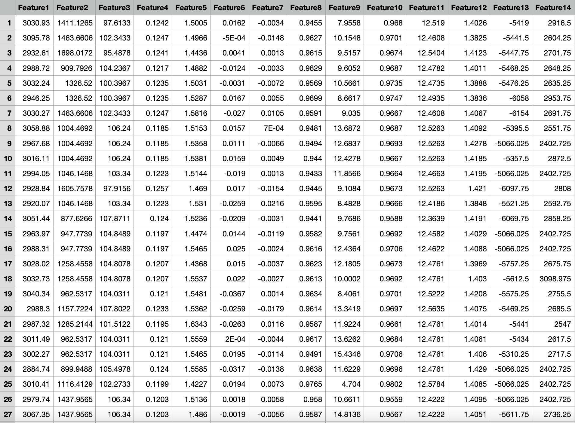
DATASET
Source - UCI/Professor
https://archive.ics.uci.edu/ml/datasets/SECOM

Slide 6
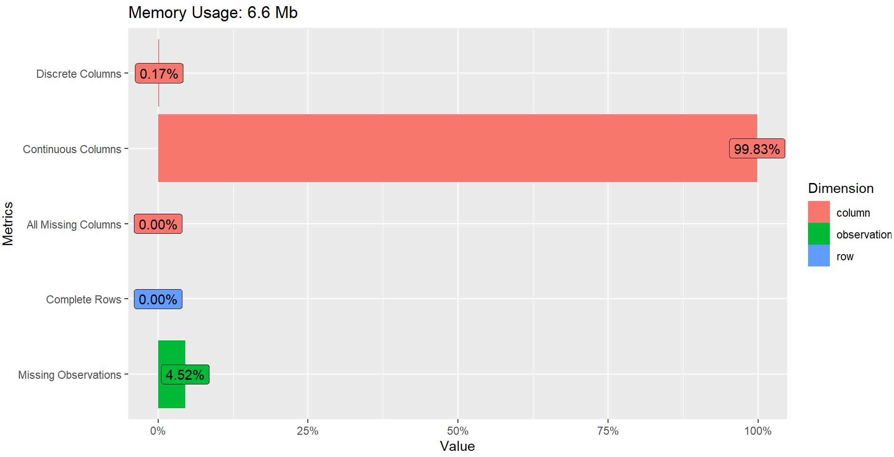
DATA SUMMARY
Rows: 1567
Columns: 592
Missing Values: 41951
Total Observations: 927664
Discrete Column: Response Variable

Slide 7
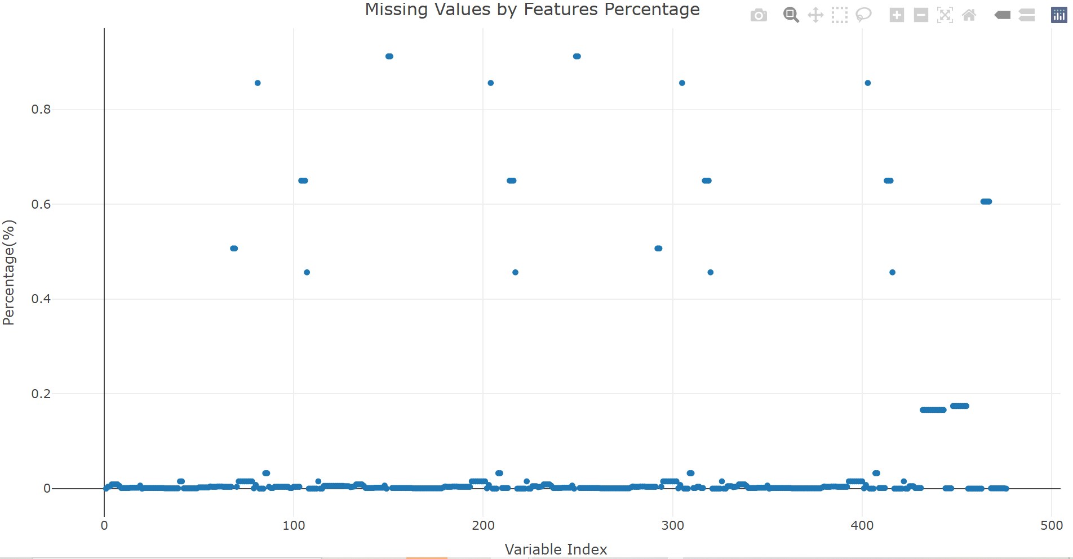
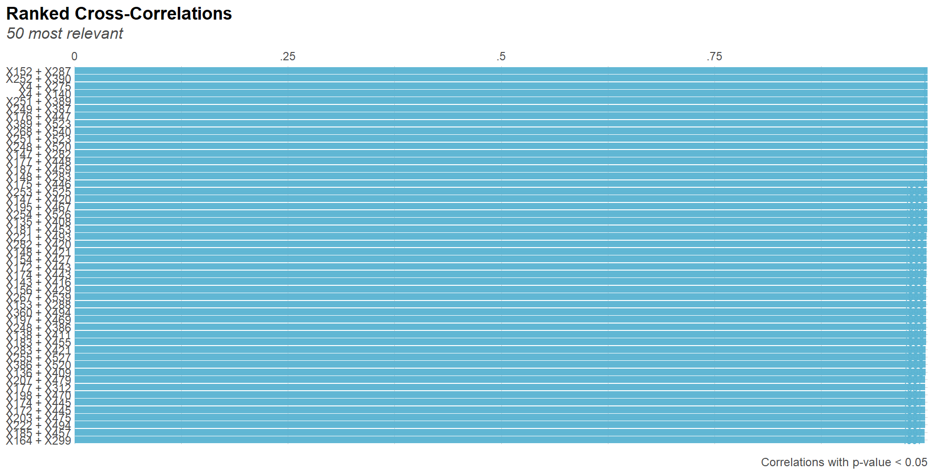
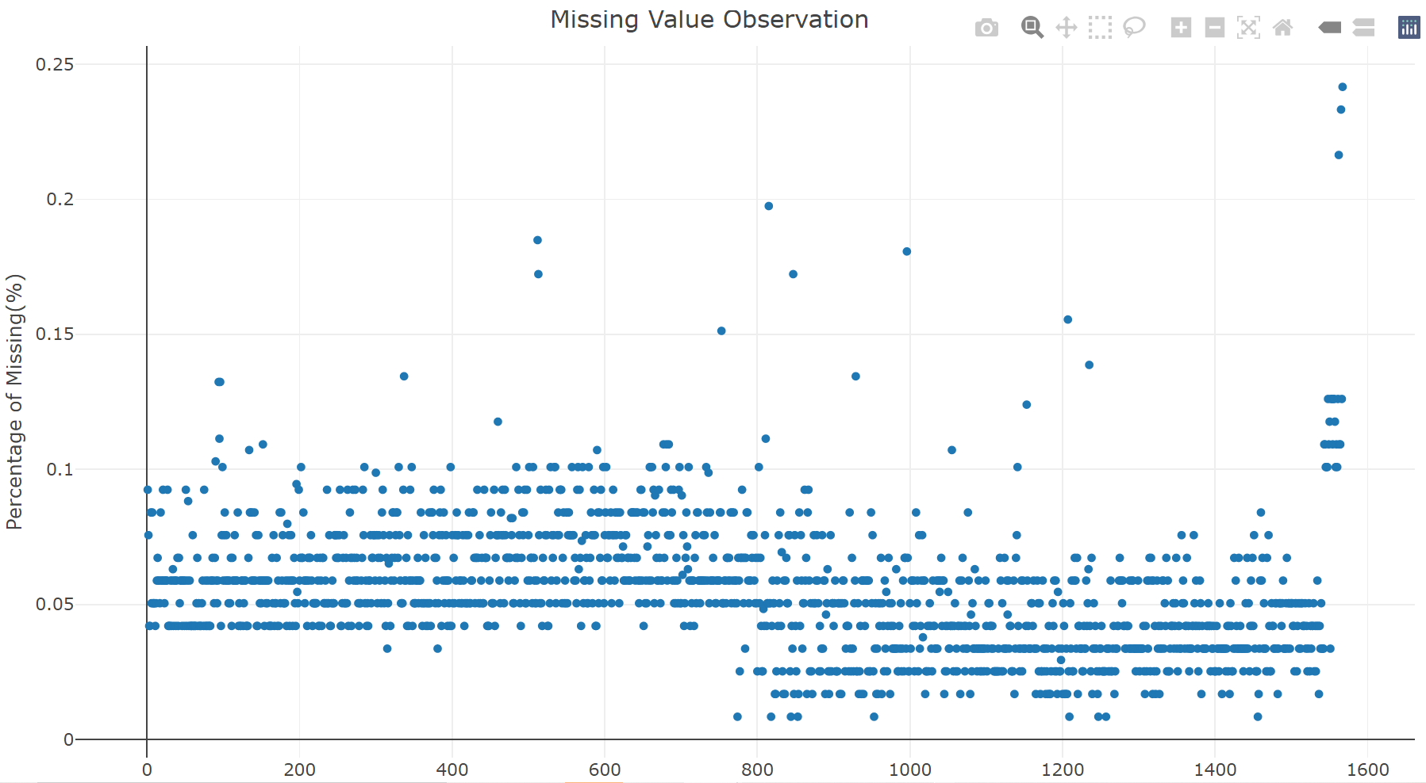
FEATURE ENGINEERING
Dealing with missing values by median imputation
Data Normalization
Multicollinearity (removed highly correlated features)
Removed low/zero correlated features with target variable
Removed insignificant columns

Slide 8
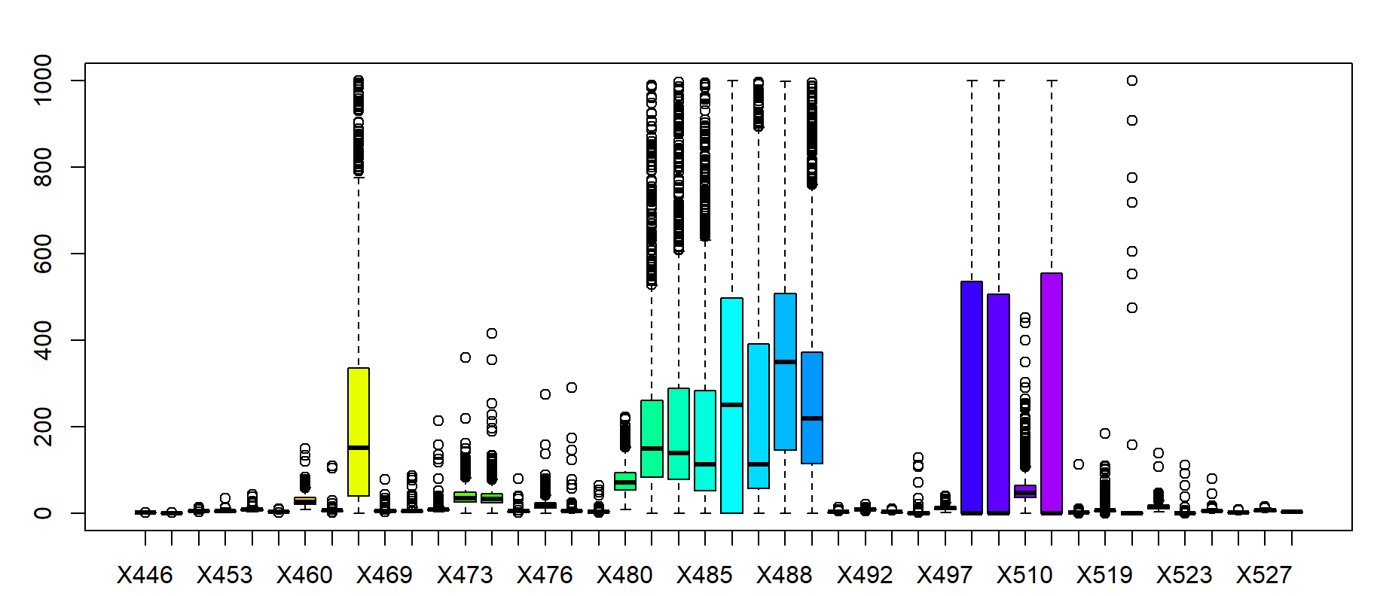
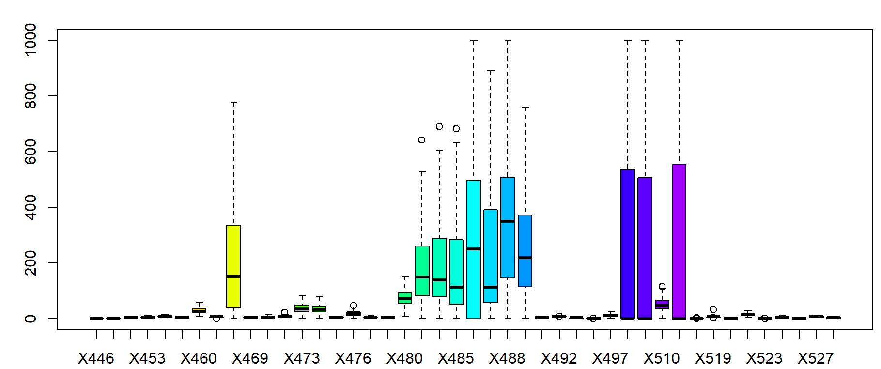
OUTLIER ANALYSIS
The sensor measurements could not be wrong, but for the purpose of model building we must deal with the outliers.
Sensor measurements were fine-tuned within the range.
The boxplots demonstrate the before (almost
all the features have huge outliers) and after
scenarios.
BEFORE
AFTER

Slide 9
DIMENSIONALITY REDUCTION
590
Features
213
Feature reduction process is done using Feature Engineering that aligns with principal component analysis
Features

Slide 10
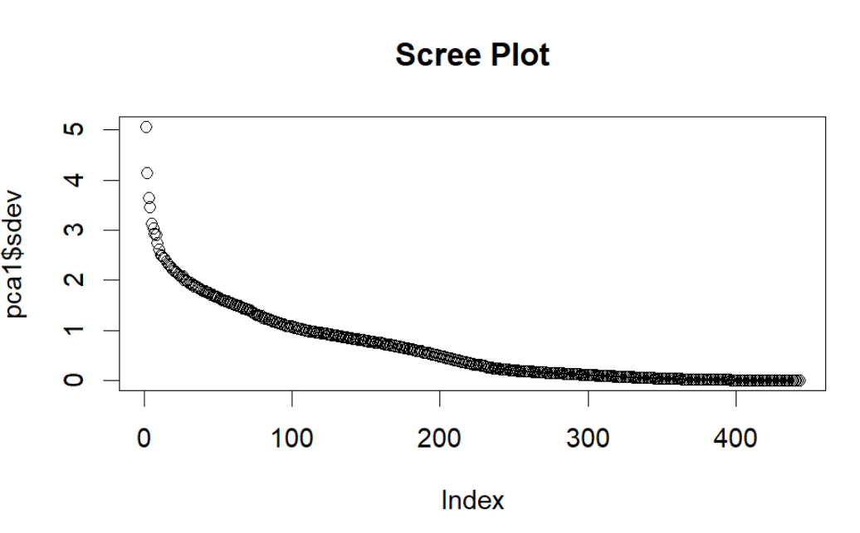
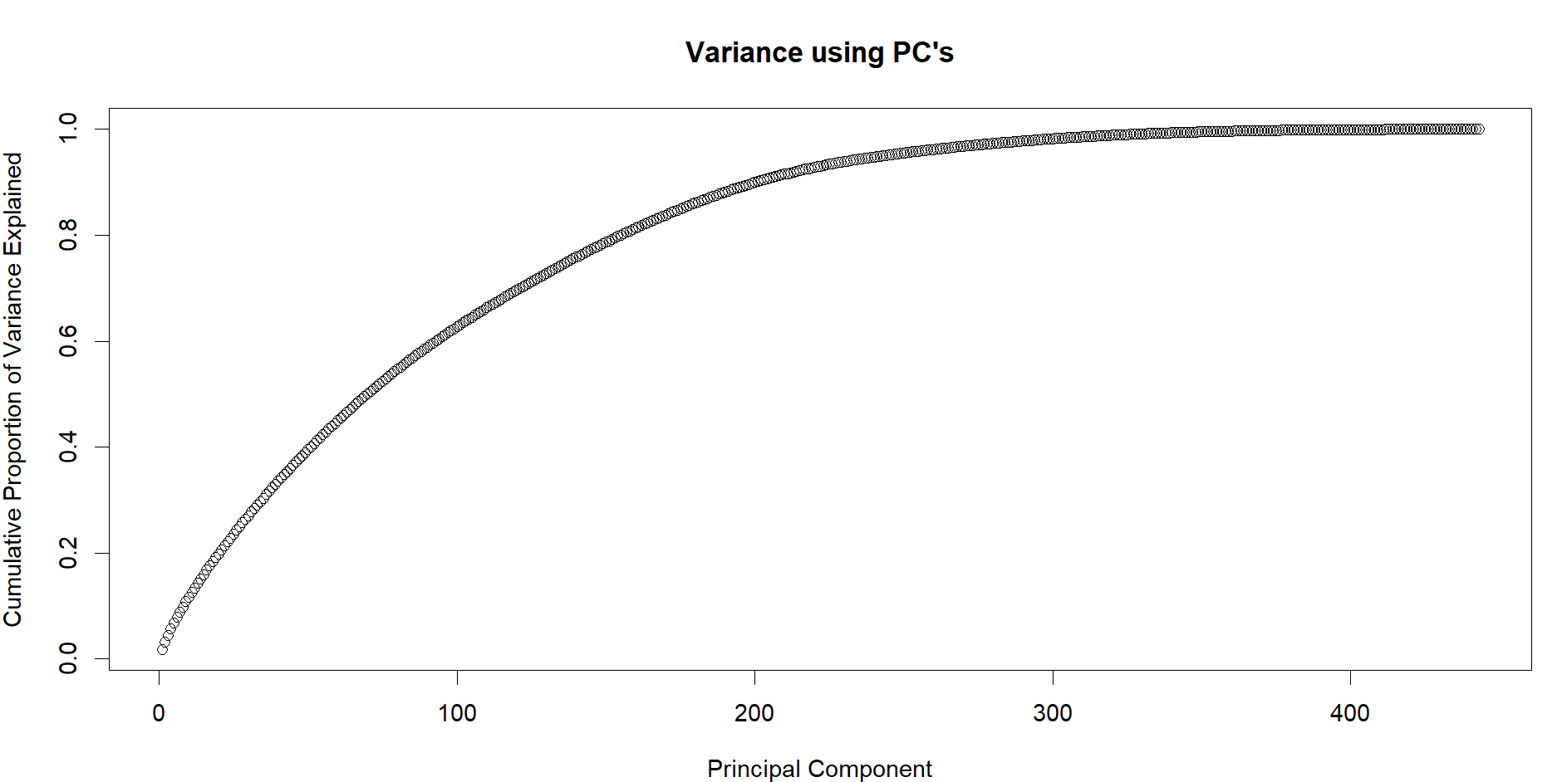
PRINCIPAL COMPONENT ANALYSIS

Slide 11
LOGISTIC REGRESSION
1

Slide 12
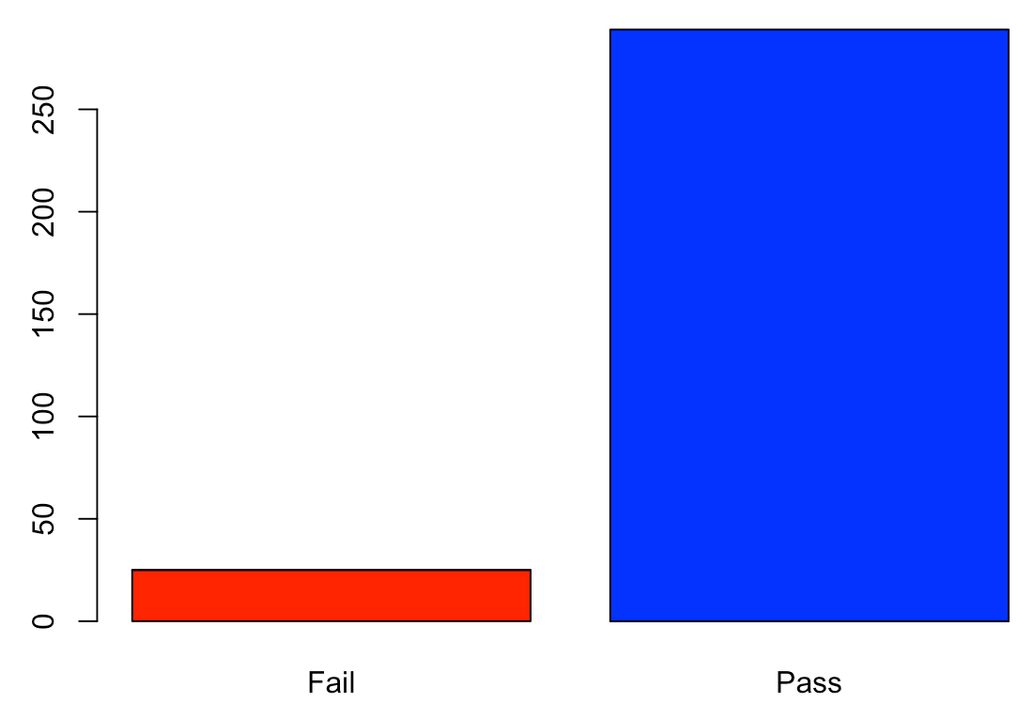
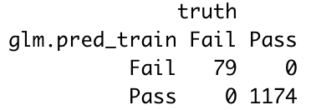
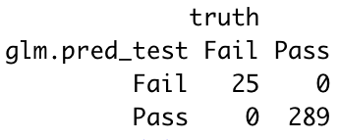
ANALYTICAL RESULTS
Model gave high accuracy results
Generalized linear model using glm function in R
Zero misclassifications and no overfitting issues as test accuracy is good too
We would choose this as it is easier to interpret and it is computationally less expensive
But we are exploring further models too throughout the analysis
The bar plot shows the comparison of the number of ‘Pass’ and ‘Fail’ attributes
Both confusion matrices show 100% for accuracy, sensitivity and specificity

Slide 13
DECISION TREE RANDOM FOREST BAGGING BOOSTING
2

Slide 14
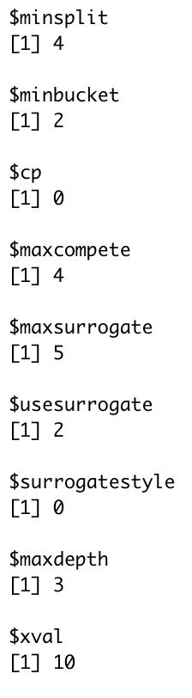
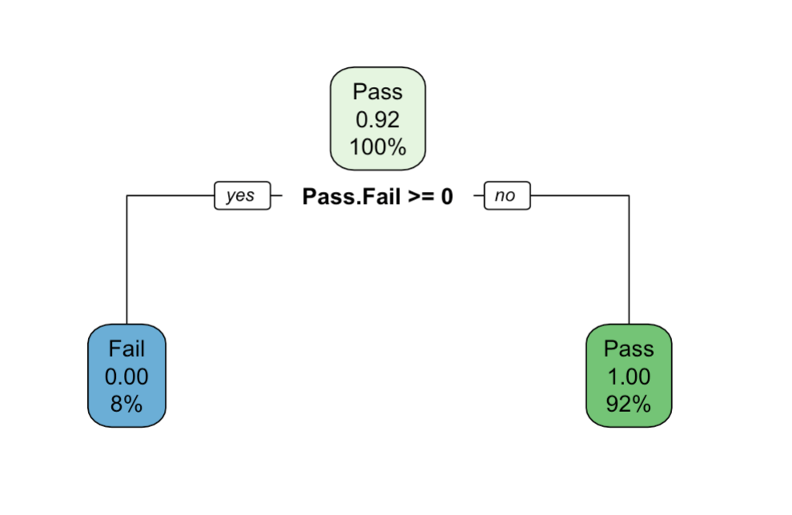
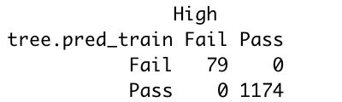
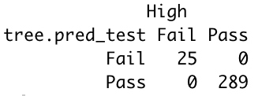
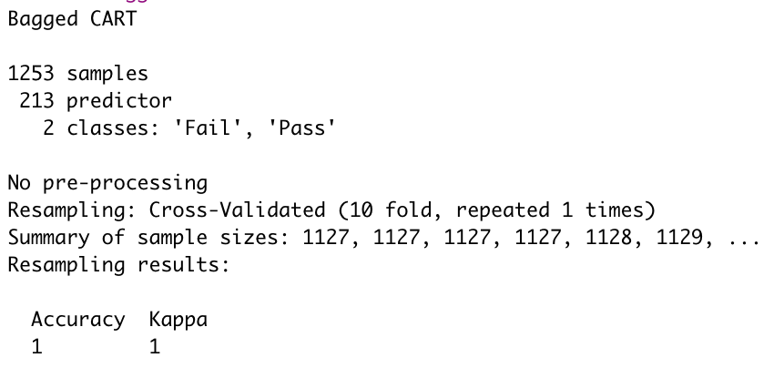
DECISION TREE
Bagging/Boosting methods gave 100% Accuracy, Sensitivity and Specificity
The high value of accuracy is expected as Decision Tree uses parallel and sequential computation methods
Data has been feature engineered well as there are no bias/variance issues

Slide 15
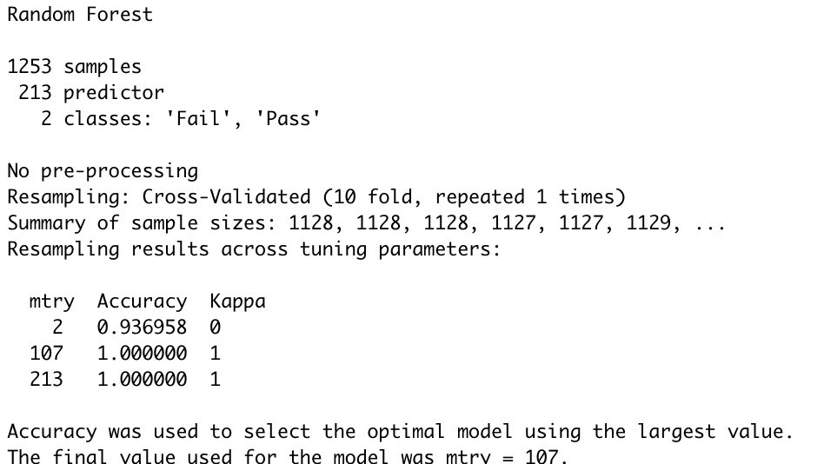
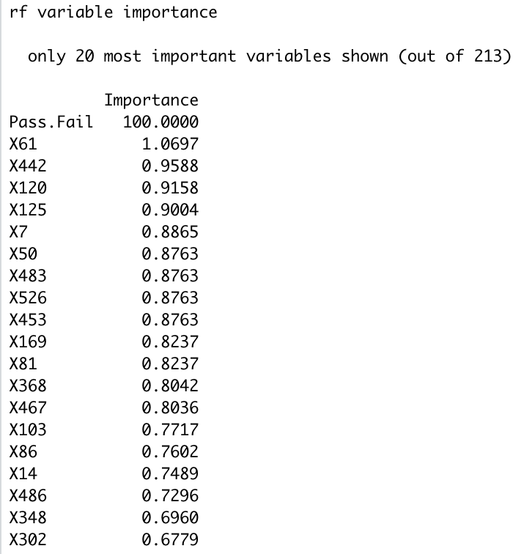
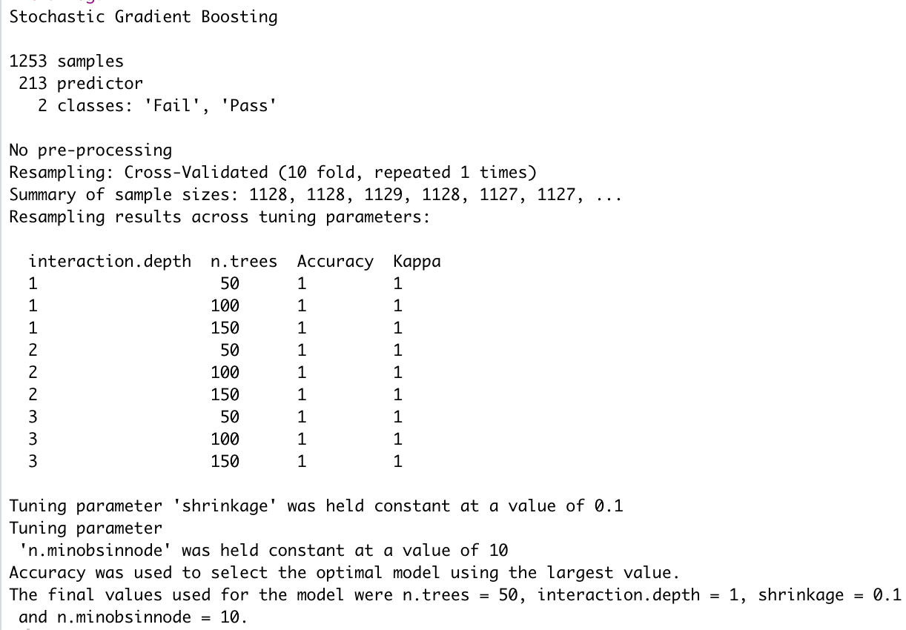
RANDOM FOREST
Data was randomised using 10-folds cross validation
Random forest and Random forest using stochastic gradient boosting gave the 100% accuracy, sensitivity and specificity
Number of variables randomly sampled at each split was 107

Slide 16
K - NEAREST
NEIGHBOR
3

Slide 17
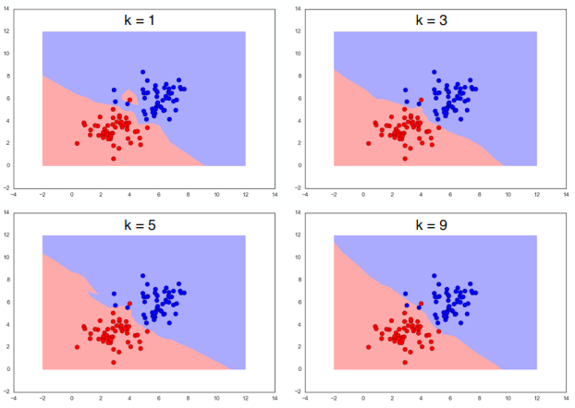
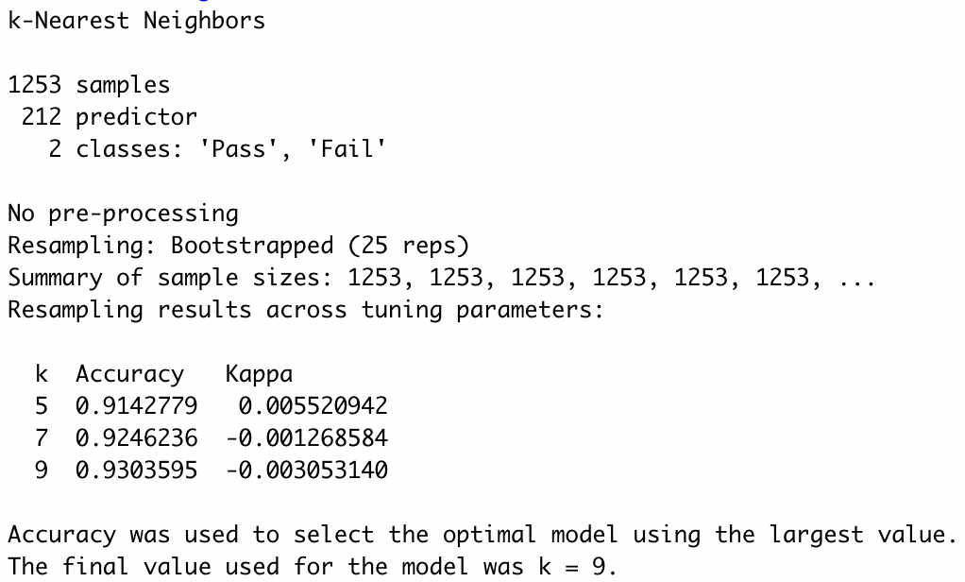
ANALYTICAL RESULTS
Accuracy plot for various k values
K-Nearest Neighbor Comparative Analysis

Slide 18
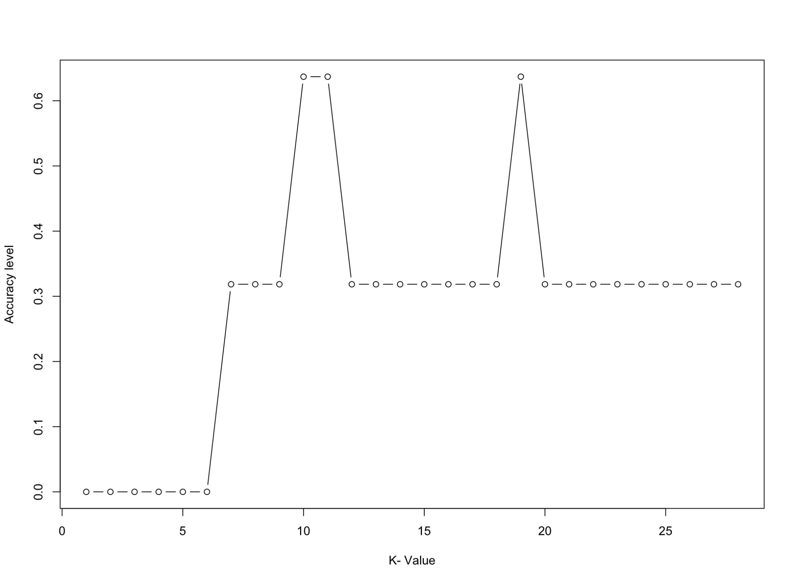
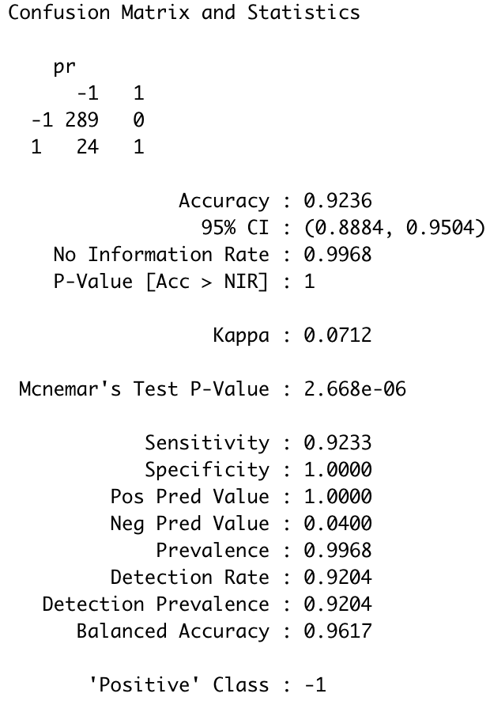
The k-nearest neighbor model achieves an impressive accuracy of 92.36%
with a k - value of 9. When updated, this k value begins to improve the
accuracy of the model
The accuracy plot depicts that the model achieves high accuracy for k values
9, 11 and 19.
ACCURACY METRICS
ACCURACY PLOT

Slide 19
SUPPORT VECTOR MACHINE
4

Slide 20
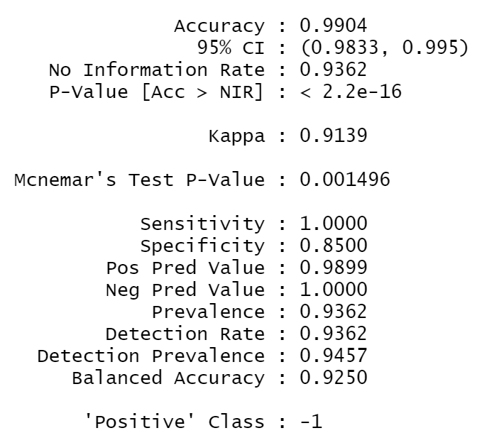
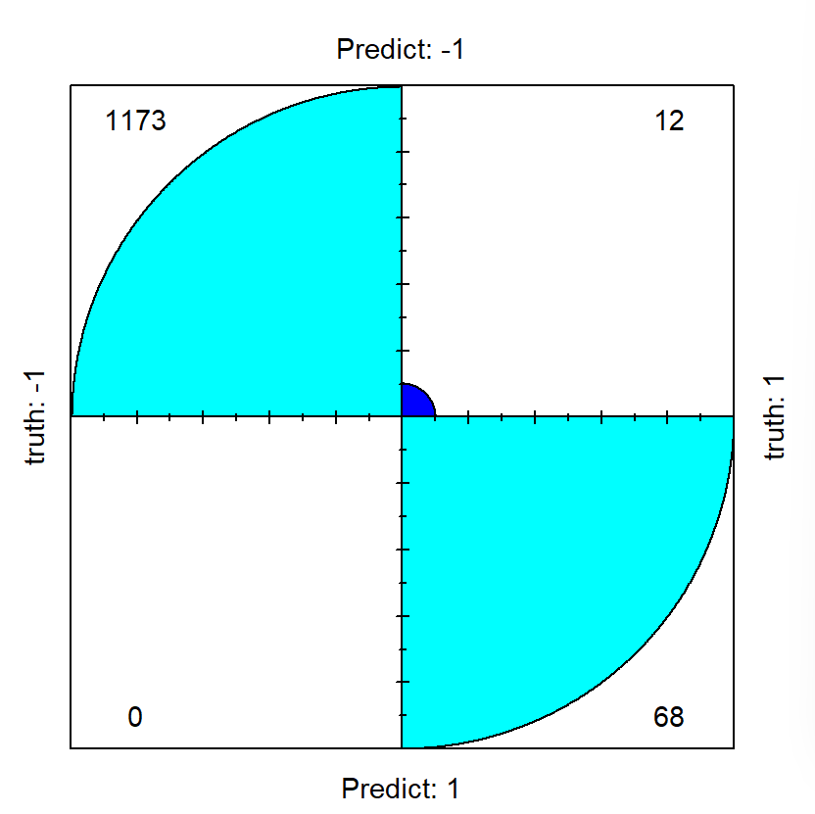
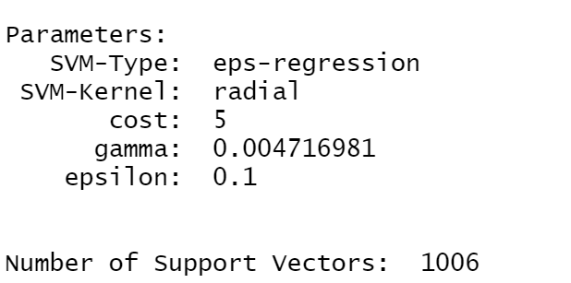
OPTIMIZATION- BEHAVIOUR
Approach:
The SVM tuning is carried out with Linear Kernel, Polynomial Kernel, Gaussian Radial Basis Function (RBF), and Sigmoid Kernel. Selected is the RBF.
Randomized train test split is performed. A loop of 10 distinct variations along with cross-validation is performed. No difference is noticed in terms of behaviour.
A perfect hyperplane with many support vectors across the margin.

Slide 21
QUALITATIVE ANALYSIS - RESULTS
Method | Accuracy | Sensitivity | Specificity
Logistic Regression | 100% | 1.000 | 1.000
Decision Tree | 100% | 1.000 | 1.000
Random Forest | 100% | 1.000 | 1.000
Bagging/Boosting | 100% | 1.000 | 1.00
Support Vector Machine | 99.04% | 1.000 | 0.8500
K - Nearest Neighbour | 92.36% | 0.9233 | 1.000

Slide 22
CONCLUSIONS
The possible reasons of obtaining the highest accuracies across all the models could be the following:
There might not be enough diversity in the collected data
Perhaps we need to further enhance the model by exploratory data analysis through hypothesis testing
We systematically followed the right process using principles/methods we were taught in class

Slide 23
ACKNOWLEDGEMENTS
Special thanks to
Dr. Scott Broderick. , University at Buffalo
Department of Materials Design and Innovation
School of Engineering and Applied Sciences

Slide 24
THANK YOU!
Any questions?

